Slide 1
Campus Resilience Program Exercise Starter Kit
Hurricane Tabletop Exercise
Exercise Conduct Briefing
[Insert Date]

Slide 2
READ FIRST
The purpose of this Exercise Conduct Briefing is to provide a baseline exercise document that institutions of higher education can use to assess their emergency plans, policies, and procedures
The sample content contained in this document can be tailored as necessary by filling in all [bracketed content that is highlighted in red]
To insert the sponsoring organization’s logo, navigate to the “View” menu and select “Slide Master”
This briefing is to be used in tandem with the Hurricane Situation Manual and Facilitator Guide so any changes made to this briefing will need to be aligned with those documents
**Delete slide prior to conduct**

Slide 3
Welcome and Introductions
[Name]
[Title]
[Department/Agency/Organization]
[Name]
[Title]
[Department/Agency/Organization]

Slide 4
Administrative Remarks
Cell phone etiquette
Evacuation procedures
Restroom locations

Slide 5
Exercise Schedule
Activity | Time
[Welcome and Introductions] | [00:00 a.m.]
[Exercise Overview] | [00:00 a.m.]
Module 1: Preparedness | [00:00 a.m.]
Break | [00:00 a.m.]
Module 2: Response | [00:00 p.m.]
Break | [00:00 p.m.]
Module 3: Short-Term Recovery | [00:00 p.m.]
[Exercise Hot Wash] | [00:00 p.m.]
[Closing Remarks] | [00:00 p.m.]

Slide 6
Exercise Overview

Slide 7
Exercise Overview
Background:
  This Tabletop Exercise (TTX) is made available through the Campus Resilience (CR) Program Exercise Starter Kits
  Each Exercise Starter Kit aims to support practitioners and senior leaders from the academic community in assessing emergency plans, policies, and procedures while also enhancing overall campus resilience
Purpose:
  This specific Exercise Starter Kit will provide the opportunity to examine preparedness, response, and recovery operations related to a hurricane

Slide 8
Exercise Overview (cont.)
Scope:
  This [insert duration]-TTX is divided into three Modules:
    Module 1 will examine preparedness operations leading up to a hurricane
    Module 2 will examine response efforts once a hurricane makes landfall
    Module 3 will examine short-term recovery operations following a hurricane
  Each Module will consist of two activities:
    Scenario Overview: Each Module will contain a detailed overview of the scenario
    Facilitated Discussions: Participants will engage in facilitated discussions surrounding a set of discussion questions

Slide 9
READ FIRST
The exercise objectives contained in the following slide(s) are provided as sample objectives
These can be tailored as appropriate to align with the overarching goals and desired outcomes for the exercise
Please note that changes made to these objectives will need to be reflected in the associated Facilitator Guide and Situation Manual for this scenario
**Delete slide prior to conduct**

Slide 10
Exercise Objectives
Operational Coordination: Assess the ability to establish an effective command structure that integrates all critical stakeholders to ensure campus and community resources are used efficiently to prepare for, respond to, and recover from a hurricane impacting campus operations
Mass Care Services: Examine the ability to provide life-sustaining and human services to affected populations at your institution to include hydration, feeding, sheltering, temporary housing, evacuee support, reunification, and distribution of emergency supplies
Infrastructure Systems: Evaluate the ability to protect, restore, and revitalize your institution’s critical infrastructure systems and assets to minimize threats to health and safety
Public Information and Warning: Assess the ability to deliver coordinated, actionable, and timely information to critical partners and stakeholders when faced with a hurricane impacting campus operations

Slide 11
Participant Roles and Responsibilities
Facilitator: Provides situation updates and facilitates discussions
Players: Respond to the situation presented based on current plans, policies, and procedures
Observers: Visit or view selected segments of the exercise without directly engaging in exercise discussions
Support Staff: Performs administrative and logistical support during the exercise (e.g., registration)
[Insert additional participant roles as appropriate]

Slide 12
Participating Organizations
[Insert Participating Organization]
  [Insert Participating Sub-Organization]
[Insert Participating Organization]
  [Insert Participating Sub-Organization]
[Insert Participating Organization]
  [Insert Participating Sub-Organization]

Slide 13
Exercise Guidelines
This exercise is being conducted in an open, low-stress, no-fault environment; varying viewpoints, even disagreements, are expected
Act in real-world roles for your institution or organization when considering the scenario
Decisions are not precedent-setting; this is an open discussion
The focus should be on identifying suggestions and recommended actions for improving preparedness, response, and recovery efforts
[Insert any additional guidelines that may be relevant to the exercise]

Slide 14
Assumptions and Artificialities
The exercise scenario is plausible and events occur as they are presented
Players will use existing plans, policies, procedures, and resources to guide responses
There is no “hidden agenda” nor are there any trick questions
The scenario assumes certain player actions as it moves through each phase; players should first discuss the actions stipulated by the scenario
Players are welcome to engage in “what if” discussions of alternative scenario conditions
[Insert any additional assumptions or artificialities that may be relevant to the exercise]

Slide 15
Start of Exercise

Slide 16
Module 1: Preparedness

Slide 17
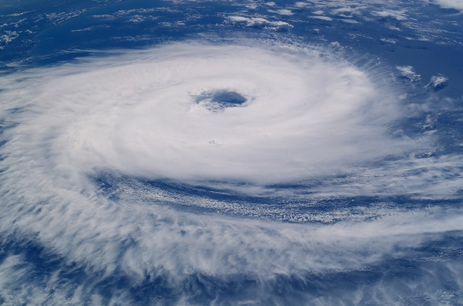
Module 1: Scenario Overview
[Insert Date and Time; 72 Hours Before Landfall]
A Category 2 hurricane is tracking towards your area
Hurricane track models from the National Hurricane Center indicate the storm will make landfall in your area
The National Weather Service warns that your area will suffer heavy rainfall, high winds, and flooding; a hurricane watch is issued
Families of students at your institution begin to reach out asking how your institution will protect student health and welfare

Slide 18
Module 1: Scenario Overview (cont.)
[Insert Date and Time; 24 Hours Before Landfall]
Other institutions in your area begin cancelling classes, athletic events, and social functions
Faculty and students express concern over the impact of potential power outages on their research equipment and lab materials

Slide 19
Module 1: Discussion Questions (1/4)
Operational Coordination
What plans, policies, and procedures does your institution have in place to prepare for an approaching hurricane?
What are your institution’s initial priorities?
How would your institution establish a command structure to coordinate your preparedness efforts?
What resource gaps could limit your institution’s ability to prepare for a hurricane?
[Insert additional discussion questions as appropriate]

Slide 20
Module 1: Discussion Questions (2/4)
Mass Care Services
What plans, policies, and procedures does your institution have in place to mitigate the disruption of essential campus services?
What risks does a hurricane pose to your institution’s facilities?
Is your institution equipped to serve as an emergency shelter?
What are your institution’s plans, policies, and procedures for conducting an evacuation?
[Insert additional discussion questions as appropriate]

Slide 21
Module 1: Discussion Questions (3/4)
Infrastructure Systems
What risks does a hurricane pose to your institution’s key infrastructure (e.g., campus facilities)?
What steps can your institution take to protect your critical infrastructure?
What plans, policies, and procedures does your institution have in place to mitigate a temporary loss off critical infrastructure?
[Insert additional discussion questions as appropriate]

Slide 22
Module 1: Discussion Questions (4/4)
Public Information and Warning
What plans, policies, and procedures does your institution have in place to guide your internal and external communications strategies?
How and when does your institution issue warnings, alerts, and other emergency messaging?
What individual, office, or department coordinates and delivers your institution’s public messaging?
How does your institution encourage students, faculty, and staff to take individual steps to mitigate the potential impacts of a hurricane?
How will your institution use social media platforms in support of incident communications and public messaging?
[Insert additional discussion questions as appropriate]

Slide 23
Break

Slide 24
Module 2: Response

Slide 25
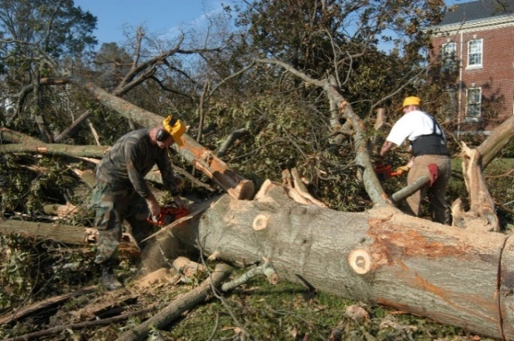
Module 2: Scenario Overview (1/3)
[Insert Date and Time; Landfall]
The hurricane makes landfall as a Category 1 storm
Roadways are flooded and trees have fallen, causing power outages across campus
Hurricane-force winds and broken branches damage multiple academic and administrative buildings
Flood affects several first-floor student housing facilities

Slide 26
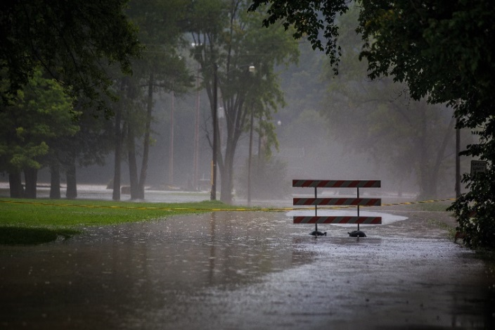
Module 2: Scenario Overview (2/3)
[Insert Date and Time; 36 Hours After Landfall]
The hurricane weakens to a tropical storm
Your institution received 10 inches of rain and experienced winds of up to 75 mph
Utility companies estimate that power outages will continue for 3 to 5 days
Local officials warn people not to drink the public water, which might have become contaminated during the storm
Law enforcement provides notification of curfews and road closures

Slide 27
Module 2: Scenario Overview (3/3)
[Insert Date and Time; 48 Hours After Landfall]
Multiple students and members of staff suffered fatal injuries in the storm and several dozen students are hospitalized
Some faculty members and students remain unaccounted for, including some international students
Local media reports on the hurricane-related fatalities spark an influx of calls and emails from anxious families

Slide 28
Module 2: Discussion Questions (1/4)
Operational Coordination
What plans, policies, and procedures does your institution have in place to guide response efforts?
How would your institution establish and maintain an effective command structure to coordinate emergency response efforts?
How do key decision-makers collect information on damages and critical needs?
What resources are currently available?
Who are the key external stakeholders that would support response efforts?
[Insert additional discussion questions as appropriate]

Slide 29
Module 2: Discussion Questions (2/4)
Mass Care Services
What plans, policies, and procedures does your institution have in place to ensure the life safety and health of all students, faculty, and staff?
What resource gaps could limit your institution’s ability to provide mass care services?
What emergency housing plans, policies, and procedures does your institution have in place?
What resource gaps could limit your institution’s ability to meet your community’s emergency housing needs?
[Insert additional discussion questions as appropriate]

Slide 30
Module 2: Discussion Questions (3/4)
Infrastructure Systems
How will your institution facilitate the speedy restoration of critical infrastructure systems and services?
How would your institution coordinate the restoration of critical infrastructure?
What mechanisms does your institution implement to ensure continuity of operations during this response period?
How does your institution collect real-time updates on the status of its critical infrastructure?
[Insert additional discussion questions as appropriate]

Slide 31
Module 2: Discussion Questions (4/4)
Public Information and Warning
How does your institution ensure consistent and coordinated public messaging throughout the initial response period?
How does your institution ensure timely and accurate situational updates for internal stakeholders throughout the response period?
Does your institution have a crisis communications plan or other means of communicating with all stakeholders in case of a breakdown of standard communications?
How does your institution notify families, key stakeholders, and the public of fatalities or serious injuries?
[Insert additional discussion questions as appropriate]

Slide 32
Break

Slide 33
Module 3: Short-Term Recovery

Slide 34
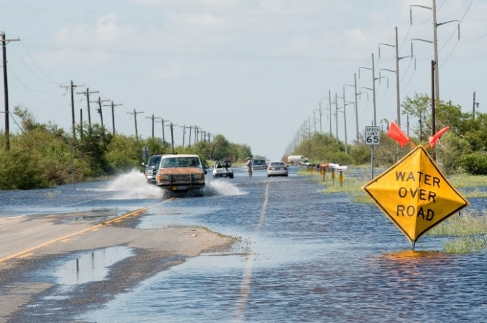
Module 3: Scenario Overview
[Insert Date and Time; Three Days After Landfall]
The storm has dissipated
Roadways around your institution remain partially flooded and clogged with debris, causing accidents
Your campus is still without power and multiple campus buildings require repair
Some student housing remains uninhabitable

Slide 35
Module 3: Scenario Overview (cont.)
[Insert Date and Time; One Week After Landfall]
Students inquire about how class cancellations will impact their academic schedules and financial requirements
Families of international students reach out to embassies and consulates to see how class cancellations will impact their children’s immigration status

Slide 36
Module 3: Discussion Questions (1/4)
Operational Coordination
How does your institution coordinate the transition from response to short-term recovery efforts?
What plans, policies, and procedures guide your institution’s recovery process?
What resource gaps could limit your institution’s ability to meet these priorities?
How well is your institution’s finance team prepared to process and submit FEMA claims?
[Insert additional discussion questions as appropriate]

Slide 37
Module 3: Discussion Questions (2/4)
Mass Care Services
What plans, policies, and procedures does your institution have in place to return your campus to a healthy and safe environment?
What long-term housing plans, policies, and procedures does your institution have in place?
What resource gaps could limit your institution’s ability to meet your community’s long-term housing needs?
[Insert additional discussion questions as appropriate]

Slide 38
Module 3: Discussion Questions (3/4)
Infrastructure Systems
Which infrastructure systems would your institution prioritize during the recovery period?
How would your institution coordinate the complete restoration of critical infrastructure?
What mechanisms does your institution have in place to maintain continuity of operations throughout the recovery period?
[Insert additional discussion questions as appropriate]

Slide 39
Module 3: Discussion Questions (4/4)
Public Information and Warning
How does your institution ensure consistent, coordinated public messaging throughout the recovery period?
How does your institution provide internal stakeholders with timely updates concerning recovery efforts?
Who is responsible for monitoring and managing inquiries from affected students, faculty, staff, and alumni?
[Insert additional discussion questions as appropriate]

Slide 40
End of Exercise

Slide 41
Exercise Hot Wash

Slide 42
Hot Wash Overview
This Hot Wash aims to capture the following information based on observations made throughout the exercise:
  Overall strengths
  Overall areas for improvement
  Major takeaways and action items

Slide 43
Closing Remarks
[Name]
[Title]
[Department/Agency/Organization]
[Name]
[Title]
[Department/Agency/Organization]

Slide 44
Adjournment

Slide 45
Campus Resilience Program Exercise Starter Kit
Hurricane Tabletop Exercise
Exercise Conduct Briefing
[Insert Date]

