Slide 1
Campus Resilience Program Exercise Starter Kit
Active Shooter Tabletop Exercise
Exercise Conduct Briefing
[Insert Date]

Slide 2
READ FIRST
The purpose of this Exercise Conduct Briefing is to provide a baseline exercise document that institutions of higher education can use to assess their emergency plans, policies, and procedures
The sample content contained in this document can be tailored as necessary by filling in all [bracketed content that is highlighted in red]
To insert the sponsoring organization’s logo, navigate to the “View” menu and select “Slide Master”
This briefing is to be used in tandem with the Active Shooter Situation Manual and Facilitator Guide so any changes made to this briefing will need to be aligned with those documents
**Delete slide prior to conduct**

Slide 3
Welcome and Introductions
[Name]
[Title]
[Department/Agency/Organization]
[Name]
[Title]
[Department/Agency/Organization]

Slide 4
Administrative Remarks
Cell phone etiquette
Evacuation procedures
Restroom locations

Slide 5
Exercise Schedule
Activity | Time
[Welcome and Introductions] | [00:00 a.m.]
[Exercise Overview] | [00:00 a.m.]
Module 1: Initial Response | [00:00 a.m.]
Break | [00:00 a.m.]
Module 2: Continued Response | [00:00 p.m.]
Break | [00:00 p.m.]
Module 3: Short-Term Recovery | [00:00 p.m.]
[Exercise Hot Wash] | [00:00 p.m.]
[Closing Remarks] | [00:00 p.m.]

Slide 6
Exercise Overview

Slide 7
Exercise Overview
Background:
This Tabletop Exercise (TTX) is made available through the Campus Resilience (CR) Program Exercise Starter Kits
Each Exercise Starter Kit aims to support practitioners and senior leaders from the academic community in assessing emergency plans, policies, and procedures while also enhancing overall campus resilience
Purpose:
This specific Exercise Starter Kit will provide the opportunity to examine response and recovery operations related to an active shooter incident

Slide 8
Exercise Overview (cont.)
Scope:
This [insert duration]-TTX is divided into three Modules:
Module 1 will examine initial response operations to an active shooter incident
Module 2 will examine continued response operations during an active shooter incident
Module 3 will examine short-term recovery operations following an active shooter incident
Each Module will consist of two activities:
Scenario Overview: Each Module will contain a detailed overview of the scenario
Facilitated Discussions: Participants will engage in facilitated discussions surrounding a set of discussion questions

Slide 9
READ FIRST
The exercise objectives contained in the following slide(s) are provided as sample objectives
These can be tailored as appropriate to align with the overarching goals and desired outcomes for the exercise
Please note that changes made to these objectives will need to be reflected in the associated Facilitator Guide and Situation Manual for this scenario
**Delete slide prior to conduct**

Slide 10
Exercise Objectives
Operational Coordination: Assess the ability to establish an effective command structure that integrates all critical stakeholders to ensure campus and community resources are used efficiently to respond to and recover from an active shooter incident.
On-Scene Security, Protection, and Law Enforcement: Evaluate the ability to provide a safe and secure environment for faculty, staff, and students, as well as first responders, during the response to an active shooter incident occurring on campus.
Mass Care Services: Examine processes and procedures to provide and coordinate mass care services to include life-sustaining and human services during the response to and recovery from an active shooter incident.
Public Information and Warning: Assess the ability to deliver coordinated, actionable, and timely information to critical partners and stakeholders when faced with an active shooter incident.
Health and Social Services: Examine the ability to protect, restore, and revitalize health and social services at your institution to promote the resilience, independence, health, and well-being of students, faculty, and staff.

Slide 11
Participant Roles and Responsibilities
Facilitator: Provides situation updates and facilitates discussions
Players: Respond to the situation presented based on current plans, policies, and procedures
Observers: Visit or view selected segments of the exercise without directly engaging in exercise discussions
Support Staff: Performs administrative and logistical support during the exercise (e.g., registration)
[Insert additional participant roles as appropriate]

Slide 12
Participating Organizations
[Insert Participating Organization]
[Insert Participating Sub-Organization]
[Insert Participating Organization]
[Insert Participating Sub-Organization]
[Insert Participating Organization]
[Insert Participating Sub-Organization]

Slide 13
Exercise Guidelines
This exercise is being conducted in an open, low-stress, no-fault environment; varying viewpoints, even disagreements, are expected
Act in real-world roles for your institution or organization when considering the scenario
Decisions are not precedent-setting; this is an open discussion
The focus should be on identifying suggestions and recommended actions for improving preparedness, response, and recovery efforts
[Insert any additional guidelines that may be relevant to the exercise]

Slide 14
Assumptions and Artificialities
The exercise scenario is plausible and events occur as they are presented
Players will use existing plans, policies, procedures, and resources to guide responses
There is no “hidden agenda” nor are there any trick questions
The scenario assumes certain player actions as it moves through each phase; players should first discuss the actions stipulated by the scenario
Players are welcome to engage in “what if” discussions of alternative scenario conditions
[Insert any additional assumptions or artificialities that may be relevant to the exercise]

Slide 15
Start of Exercise

Slide 16
Module 1: Initial Response

Slide 17
Module 1: Scenario Overview
[Insert Date and Time]
Your institution receives a report of a threatening social media post
Two hours later, an unidentified individual enters [insert building name] and opens fire in classrooms on the first floor
Bystanders begin fleeing from the [insert building name] and disperse in all directions
Students in other classrooms turn off lights and barricade doors

Slide 18
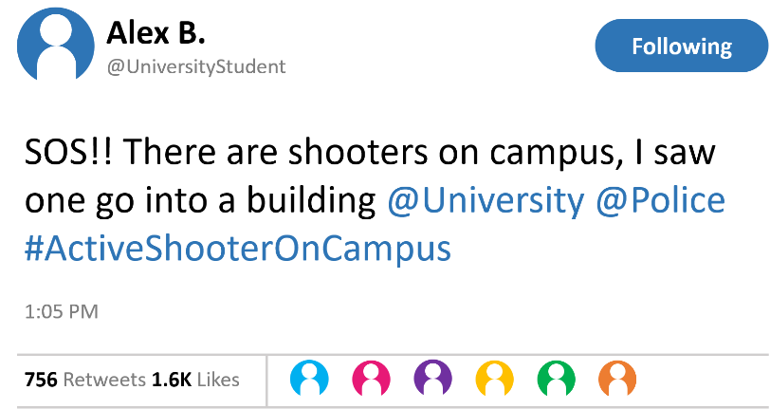
Module 1: Scenario Overview (cont.)
Campus and local 9-1-1 operators receive frantic calls reporting popping noises, screaming, and flashes of light
Students begin posting on social media about their experience, students from around campus begin to flee
A campus police officer runs into [insert building name] and hears shots coming from an upper floor, he encounters the gunman and is wounded before calling for backup
First responders arrive on the scene

Slide 19
Module 1: Discussion Questions (1/4)
Operational Coordination
What plans, policies, and procedures does your institution have in place to respond to an active shooter event?
What are your institution’s initial priorities?
How would your institution establish a command structure to coordinate your immediate response efforts?
What resource gaps could limit your institution’s ability to respond to an active shooter?
[Insert additional discussion questions as appropriate]

Slide 20
Module 1: Discussion Questions (2/4)
On-Scene Security, Protection, and Law Enforcement
In terms of securing the scene, what are the immediate priorities?
Given the situation, what protective measures would you adopt at this point?
How would initial resource needs be prioritized in the event of a secondary attack?
How are external law enforcement assets integrated with campus assets?
[Insert additional discussion questions as appropriate]

Slide 21
Module 1: Discussion Questions (3/4)
Health and Social Services
What are your institution’s immediate health and social services priorities (e.g., evacuation, shelter-in-place, additional protective measures)?
What stakeholders would you begin to coordinate with?
What critical decisions might need to be made at this point?
[Insert additional discussion questions as appropriate]

Slide 22
Module 1: Discussion Questions (4/4)
Public Information and Warning
What plans, policies, and procedures does your institution have in place to guide your internal and external communications strategies?
How and when does your institution issue warnings, alerts, and other emergency messaging?
What individual, office, or department coordinates and delivers your institution’s public messaging?
[Insert additional discussion questions as appropriate]

Slide 23
Break

Slide 24
Module 2: Continued Response

Slide 25
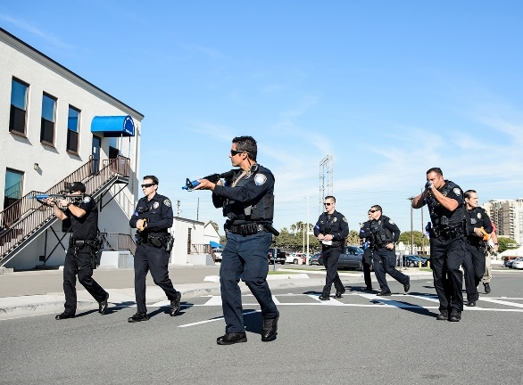
Module 2: Scenario Overview
[Insert Date and Time + 15 Minutes]
Campus and local enforcement officials arrive on scene within minutes of the first emergency call
Police quickly enter the building and begin a systematic search of each floor
The shooter barricades himself inside a stairwell; upon seeing armed officers, the gunman fatally shoots himself

Slide 26
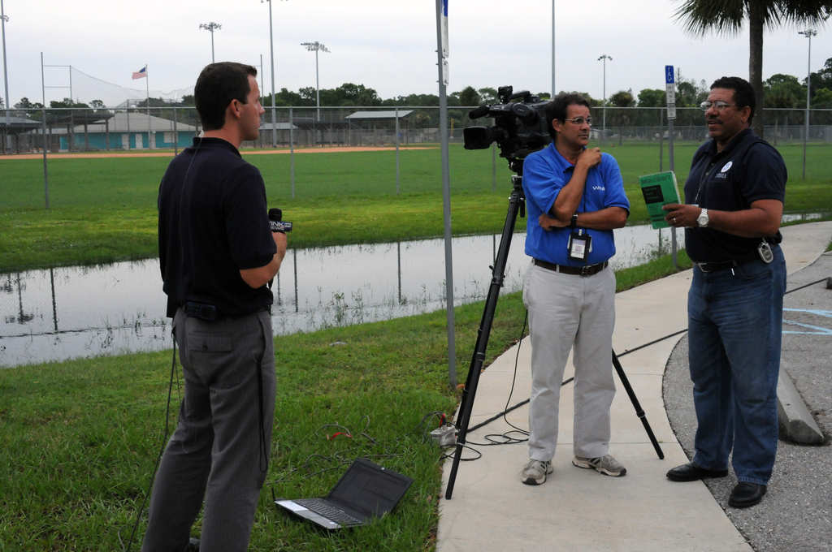
Module 2: Scenario Overview (cont.)
[Insert Date and Time + 1 Hour]
National and local media outlets begin providing coverage of the shooting
Rumors start on social media that there are multiple shooters and multiple shooting locations
Parents begin inundating campus with calls, voicing concern for their children

Slide 27
Module 2: Discussion Questions (1/4)
Operational Coordination
What plans, policies, and procedures does your institution have in place to guide response efforts at this point?
How would your institution maintain an effective command structure to coordinate emergency response efforts?
How do key decision-makers collect information to assess the extent of the situation, to include injuries and fatalities?
What resources are currently available?
Who are the key external stakeholders that would support response efforts?
[Insert additional discussion questions as appropriate]

Slide 28
Module 2: Discussion Questions (2/4)
On-Scene Security, Protection, and Law Enforcement
What response plans and protocols would your institution activate at this point?
Given the scenario, what protective measures would your institution adopt? Would your institution initiate an evacuation or a shelter-in-place?
In the event of an evacuation or a shelter-in-place, how does your institution ensure those with access and functional needs and those who do not speak English as a first language are able to follow correct procedures?
Do your campus security and law enforcement personnel have interoperable communications capabilities with external law enforcement personnel?
What strategies are in place at your institution to track deployed assets and account for deployed personnel?
[Insert additional discussion questions as appropriate]

Slide 29
Module 2: Discussion Questions (3/4)
Mass Care Services
What potential mass care challenges does this type of incident pose for emergency managers and law enforcement response personnel?
How would your institution address challenges of injured students both on-scene and those fleeing away from the scene?
Do you anticipate the need to establish a shelter at this point in the scenario?
How will your institution account for students, faculty, staff, and campus guests in affected areas?
[Insert additional discussion questions as appropriate]

Slide 30
Module 2: Discussion Questions (4/4)
Public Information and Warning
How does your institution ensure consistent, coordinated public messaging throughout this phase of response operations?
How does your institution ensure timely and accurate situational updates for internal stakeholders throughout the response period?
How and when does your institution activate its crisis communications plan?
How does your institution notify families, key stakeholders, and the public of fatalities or serious injuries?
[Insert additional discussion questions as appropriate]

Slide 31
Break

Slide 32
Module 3: Short-Term Recovery

Slide 33
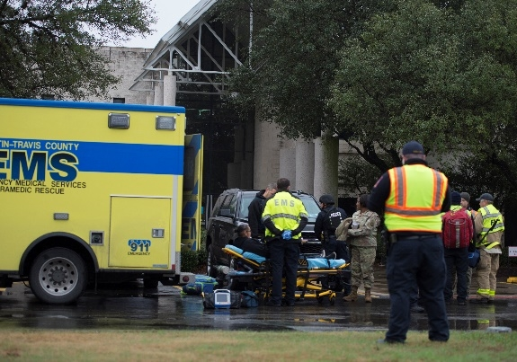
Module 3: Scenario Overview
[Insert Date and Time + 4 Hours]
Law enforcement confirms that the threat is neutralized
Injured victims are transported to healthcare facilities and hospitals
Initial estimates indicate there are approximately [number] dead and [number] injured, including two international students and one campus visitor
Local and national media continue to cover the shooting and students post on social media that they are worried about returning to campus
Worried parents continue to call your institution

Slide 34
Module 3: Discussion Questions (1/4)
Operational Coordination
How does your institution coordinate the transition from response to short-term recovery efforts?
What plans, policies, and procedures guide your institution’s recovery process?
What resource gaps could limit your institution’s ability to meet these priorities?
[Insert additional discussion questions as appropriate]

Slide 35
Module 3: Discussion Questions (2/4)
On-Scene Security, Protection, and Law Enforcement
What plans or procedures are in place to manage and secure the scene following the incident?
What additional stakeholders would be engaged to assist with these efforts?
What is your process for tracking the status and location of individuals who have been injured or fatally wounded?
What plans are in place for managing the presence of media and families on-site?
[Insert additional discussion questions as appropriate]

Slide 36
Module 3: Discussion Questions (3/4)
Mass Care Services & Health and Social Services
What are your institution’s mass care and health and social services priorities transitioning into the recovery process?
How does your institution coordinate, support, and track injuries and fatalities across the campus community?
What plans or policies are in place to support affected populations?
[Insert additional discussion questions as appropriate]

Slide 37
Module 3: Discussion Questions (4/4)
Public Information and Warning
How does your institution ensure consistent, coordinated public messaging throughout the recovery period?
How does your institution provide internal stakeholders with timely updates concerning recovery efforts?
Who is responsible for monitoring and managing inquiries from affected students, faculty, staff, and alumni?
How would you maintain overall brand reputation for an incident involving an active shooter attack?
[Insert additional discussion questions as appropriate]

Slide 38
End of Exercise

Slide 39
Exercise Hot Wash

Slide 40
Hot Wash Overview
This Hot Wash aims to capture the following information based on observations made throughout the exercise:
Overall strengths
Overall areas for improvement
Major takeaways and action items

Slide 41
Closing Remarks
[Name]
[Title]
[Department/Agency/Organization]
[Name]
[Title]
[Department/Agency/Organization]

Slide 42
Adjournment

Slide 43
Campus Resilience Program Exercise Starter Kit
Active Shooter Tabletop Exercise
Exercise Conduct Briefing
[Insert Date]

